Slide 1
Chapter 7: Software Testing

Slide 2
Software Testing
Why should We Test ?
Although software testing is itself an expensive activity, yet launching of software without testing may lead to cost potentially much higher than that of testing, specially in systems where human safety is involved.
In the software life cycle the earlier the errors are discovered and removed, the lower is the cost of their removal.

Slide 3
Software Testing
What is Testing?
Many people understand many definitions of testing :
Testing is the process of demonstrating that errors are not present.
The purpose of testing is to show that a program performs its intended
functions correctly.
Testing is the process of establishing confidence that a program does what
it is supposed to do.
These definitions are incorrect.

Slide 4
Appropriate definition
A more appropriate definition is:
“Testing is the process of executing a program with the intent of finding errors.”

Slide 5
Software Testing
Who should Do the Testing ?
Testing requires the developers to find errors from their software.
It is difficult for software developer to point out errors from own
creations.
Many organizations have made a distinction between development and testing phase by making different people responsible for each phase.

Slide 6
Software Testing
What should We Test ?
We should test the program’s responses to every possible input. It means, we should test for all valid and invalid inputs. Suppose a program requires two 8 bit integers as inputs. Total possible combinations are 2⁸x2⁸. If only one second is required to execute one set of inputs, it may take 18 hours to test all combinations. Practically, inputs are more than two and size is also more than
8 bits. We have also not considered invalid inputs where so many combinations are possible. Hence, complete testing is just not possible,
although, we may wish to do so.
Notes:
Valid inputs conform to all rules and expected formats, while invalid inputs are data that do not, such as incorrect data types, inappropriate values, or improper formatting

Slide 7
Testing
Software Testing
Software testing is the process of executing a program ( or a part of
program) with the intent of finding errors.
According to [DAHL72], software testing can’t show the absence of errors, it
can only show that errors are present
The essence of software testing is to determine a set of test cases for the software being tested.
Effective software testing will contribute to the delivery of higher quality software products, more satisfied users, lower maintenance costs, more accurate , and reliable results.
Copyright © Amity University

Slide 8
Software Testing
Some Terminologies
Error, Mistake, Bug, Fault and Failure
People make errors. A good synonym is mistake. This may be a syntax error
or misunderstanding of specifications. Sometimes, there are logical errors.
When developers make mistakes while coding, we call these mistakes “bugs”.
A fault is the representation of an error, where representation is the mode of expression, such as narrative text, data flow diagrams, ER diagrams, source code etc. Defect is a good synonym for fault.
A failure occurs when a fault executes. A particular fault may cause different
failures, depending on how it has been exercised.
Notes:
A syntax error is a mistake in the spelling or grammar of a programming language that prevents code from being compiled or executed. Common examples include misspelling a command, missing a bracket or semicolon, or using incorrect punctuation. These errors are detected by the compiler or interpreter because the code violates the language's strict rules

Slide 9
Software Testing
Test, Test Case and Test Suite
Test and Test case terms are used interchangeably. In practice, both are same and are treated as synonyms. Test case describes an input description and an expected output description.
Test Case ID
Section-I (Before Execution) | Section-II (After Execution)
Purpose : | Execution History:
Pre condition: (If any) | Result:
Inputs: | If fails, any possible reason (Optional);
Expected Outputs: | Any other observation:
Post conditions: | Any suggestion:
Written by: | Run by:
Date: | Date:
Fig. 2: Test case template
The set of test cases is called a test suite. Hence any combination of test cases may generate a test suite.

Slide 10
What is Software Testing?
Software Testing is evaluation of the software against requirements gathered from users and system specifications.
Testing is conducted at the phase level in software development life cycle or at module level in program code.
Software testing comprises of Validation and Verification.

Slide 11
Software Testing
Verification and Validation
Verification is the process of evaluating a system or component to determine whether the products of a given development phase satisfy the conditions imposed at the start of that phase.
Validation is the process of evaluating a system or component during or at the end of development process to determine whether it satisfies the specified requirements .
Testing= Verification+Validation

Slide 12
Software Testing
Alpha, Beta and Acceptance Testing
The term Acceptance Testing is used when the software is developed for a specific customer. A series of tests are conducted to enable the customer to validate all requirements. These tests are conducted by the end user / customer and may range from adhoc tests to well planned systematic series of tests.
The terms alpha and beta testing are used when the software is developed as a product for anonymous customers.
Alpha Tests are conducted at the developer’s site by some potential customers. These tests are conducted in a controlled environment. Alpha testing may be started when formal testing process is near completion.
Beta Tests are conducted by the customers / end users at their sites. Unlike alpha testing, developer is not present here. Beta testing is conducted in a real environment that cannot be controlled by the developer.

Slide 13
Software Testing
Structural Testing
A complementary approach to functional testing is called structural / white box testing. It permits us to examine the internal structure of the program.
Path Testing
Path testing is the name given to a group of test techniques based on judiciously selecting a set of test paths through the program. If the set of paths is properly chosen, then it means that we have achieved some measure of test thoroughness.
This type of testing involves:
generating a set of paths that will cover every branch in the program.
finding a set of test cases that will execute every path in the set of program
paths.
1
1

Slide 14
Testing Levels
Testing itself may be defined at various levels of SDLC.
The testing process runs parallel to software development.
Before jumping on the next stage, a stage is tested, validated and verified.
Testing separately is done just to make sure that there are no hidden bugs or issues left in the software.
Software is tested on various levels

Slide 15
Regression Testing
Whenever a software product is updated with new code, feature or functionality, it is tested thoroughly to detect if there is any negative impact of the added code.
This is known as regression testing.

Slide 16
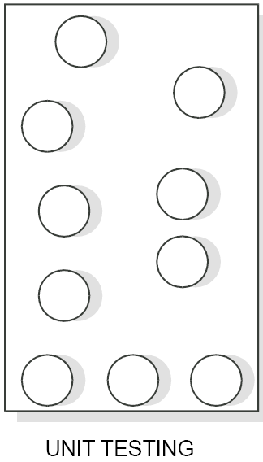
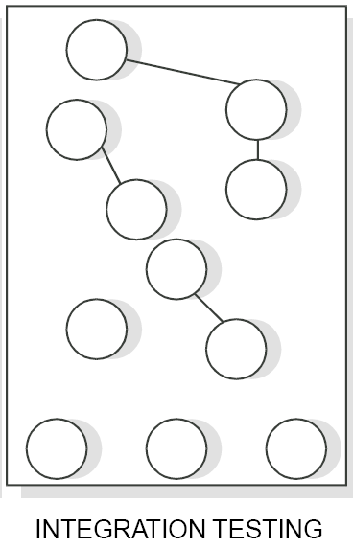
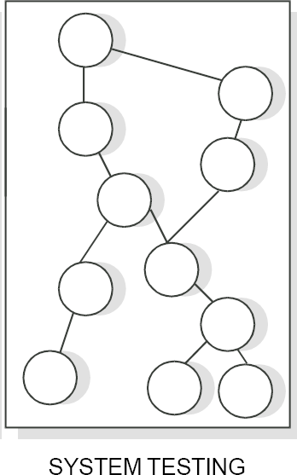
Software Testing
Levels of Testing
There are 3 levels of testing:
Unit Testing
Integration Testing
System Testing

Slide 17
Software Testing
Unit Testing
There are number of reasons in support of unit testing than testing the entire product.
The size of a single module is small enough that we can locate an error fairly easily.
The module is small enough that we can attempt to test it in some demonstrably exhaustive fashion.
Confusing interactions of multiple errors in widely different parts of the
software are eliminated.

Slide 18
Software Testing
There are problems associated with testing a module in isolation. How do we run a module without anything to call it, to be called by it or, possibly, to output intermediate values obtained during execution? One approach is to construct an appropriate driver routine to call if and, simple stubs to be called by it, and to insert output statements in it.
Stubs serve to replace modules that are subordinate to (called by) the module to be tested. A stub or dummy subprogram uses the subordinate module’s interface, may do minimal data manipulation, prints verification of entry, and returns.
This overhead code, called scaffolding represents effort that is import to
testing, but does not appear in the delivered product as shown in Fig. 29.
1
5

Slide 19
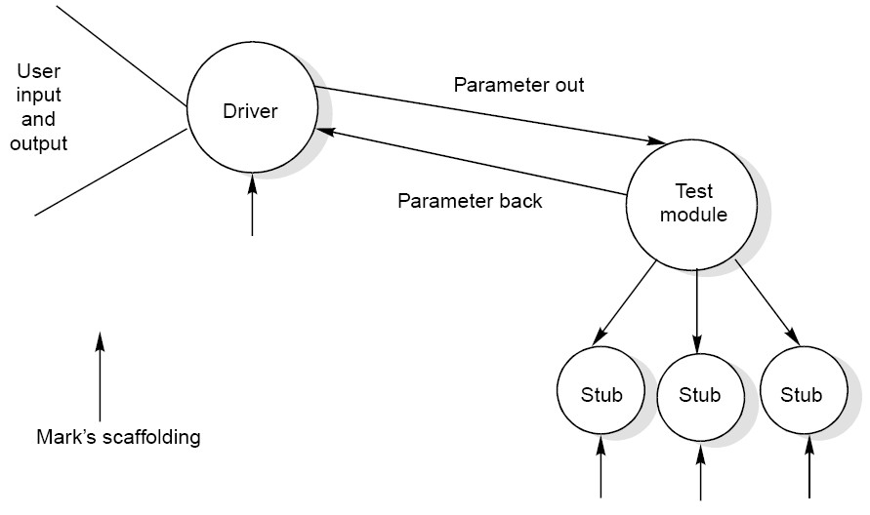
Software Testing
Fig. 29 : Scaffolding required testing a program unit (module)

Slide 20
Software Testing
Integration Testing
The purpose of unit testing is to determine that each independent module is correctly implemented. This gives little chance to determine that the interface between modules is also correct, and for this reason integration testing must be performed. One specific target of integration testing is the interface: whether parameters match on both sides as to type, permissible ranges, meaning and utilization.

Slide 21
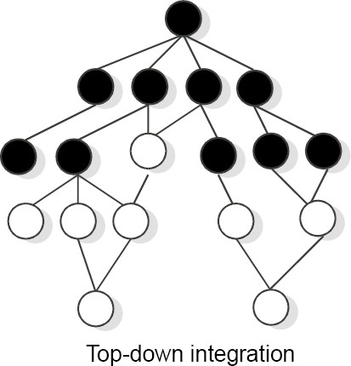
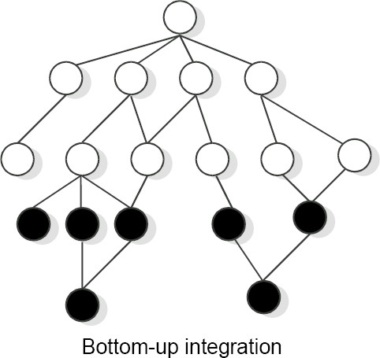
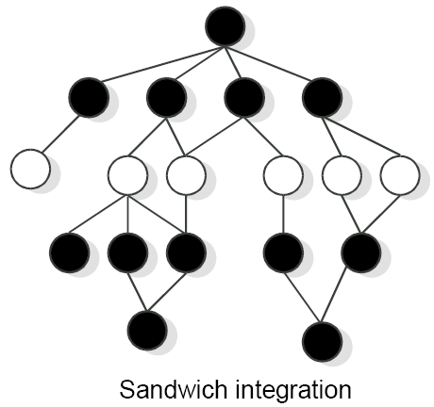
Software Testing
Fig. 30 : Three different integration approaches

Slide 22
Software Testing
System Testing
Of the three levels of testing, the system level is closet to everyday experiences. We test
many things; a used car before we buy it, an on-line cable network service before we
subscribe, and so on. A common pattern in these familiar forms is that we evaluate a product in terms of our expectations; not with respect to a specification or a standard. Consequently, goal is not to find faults, but to demonstrate performance. Because of this we tend to approach system testing from a functional standpoint rather than from a structural one. Since it is so intuitively familiar, system testing in practice tends to be less formal than it might be, and is compounded by the reduced testing interval that usually remains before a delivery deadline.
Petschenik gives some guidelines for choosing test cases during system testing.

Slide 23
Software Testing
During system testing, we should evaluate a number of attributes of the software that are vital to the user and are listed in Fig. 31. These represent the operational correctness of the product and may be part of the software specifications.
Usable | Is the product convenient, clear, and predictable?
Secure | Is access to sensitive data restricted to those with authorization?
Compatible | Will the product work correctly in conjunction with existing data, software, and procedures?
Dependable | Do adequate safeguards against failure and methods for recovery exist in the product?
Documented | Are manuals complete, correct, and understandable?
Fig. 31 : Attributes of software to be tested during system testing

Slide 24
Software Testing
Validation Testing
It refers to test the software as a complete product.
This should be done after unit & integration testing.
Alpha, beta & acceptance testing are nothing but the various ways of involving customer during testing.

Slide 25
Software Testing
Validation Testing
IEEE has developed a standard (IEEE standard 1059-1993) entitled “ IEEE guide for software verification and validation “ to provide specific guidance about planning and documenting the tasks required by the standard so that the customer may write an effective plan.
Validation testing improves the quality of software product in terms of functional capabilities and quality attributes.

Slide 26
Software Testing
The Art of Debugging
The goal of testing is to identify errors (bugs) in the program. The process of testing generates symptoms, and a program’s failure is a clear symptom of the presence of an error. After getting a symptom, we begin to investigate the cause and place of that error. After identification of place, we examine that portion to identify the cause of the problem. This process is called debugging.
Debugging Techniques
Pressman explained few characteristics of bugs that provide some clues.
“The symptom and the cause may be geographically remote. That is, the symptom may appear in one part of a program, while the cause may actually be located in other part. Highly coupled program structures may complicate this situation.
The symptom may disappear (temporarily) when another error is corrected.

Slide 27
Software Testing
The symptom may actually be caused by non errors (e.g. round off inaccuracies).
The symptom may be caused by a human error that is not easily traced.
The symptom may be a result of timing problems rather than processing problems.
It may be difficult to accurately reproduce input conditions (e.g. a real time application in which input ordering is indeterminate).
The symptom may be intermittent. This is particularly common in embedded system that couple hardware with software inextricably.
The symptom may be due to causes that are distributed across a number of tasks running on different processors”.

Slide 28
Software Testing
Induction approach
Locate the pertinent data
Organize the data
Devise a hypothesis
Prove the hypothesis

Slide 29
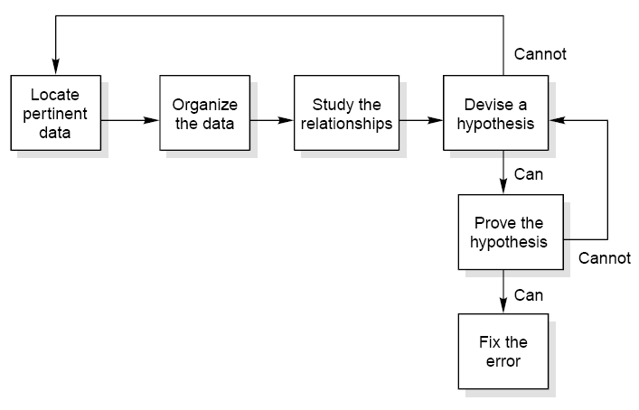
Software Testing
Fig. 32 : The inductive debugging process

Slide 30
Software Testing
Deduction approach
Enumerate the possible causes or hypotheses
Use the data to eliminate possible causes
Refine the remaining hypothesis
Prove the remaining hypothesis

Slide 31
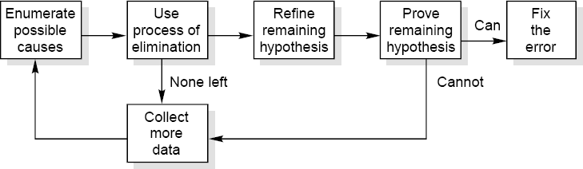
Software Testing
Fig. 33 : The inductive debugging process

Slide 32
Software Testing
Testing Tools
One way to improve the quality & quantity of testing is to make the process as pleasant as possible for the tester. This means that tools should be as concise, powerful & natural as possible.
The two broad categories of software testing tools are :
Static
Dynamic

Slide 33
Software Testing
There are different types of tools available and some are listed below:
Static analyzers, which examine programs systematically and automatically.
Code inspectors, who inspect programs automatically to make sure they adhere to minimum quality standards.
standards enforcers, which impose simple rules on the developer.
Coverage analysers, which measure the extent of coverage.
Output comparators, used to determine whether the output in a program is appropriate or not.
31

Slide 34
Software Testing
Test file/ data generators, used to set up test inputs.
Test harnesses, used to simplify test operations.
Test archiving systems, used to provide documentation about programs.

Slide 35

🞂​ Component testing
Testing of individual program components;
Usually the responsibility of the component developer
(except sometimes for critical systems);
Tests are derived from the developer’s experience.
🞂​ System testing
Testing of groups of components integrated to create a system or sub-system;
The responsibility of an independent testing team;
Tests are based on a system specification.

Slide 36

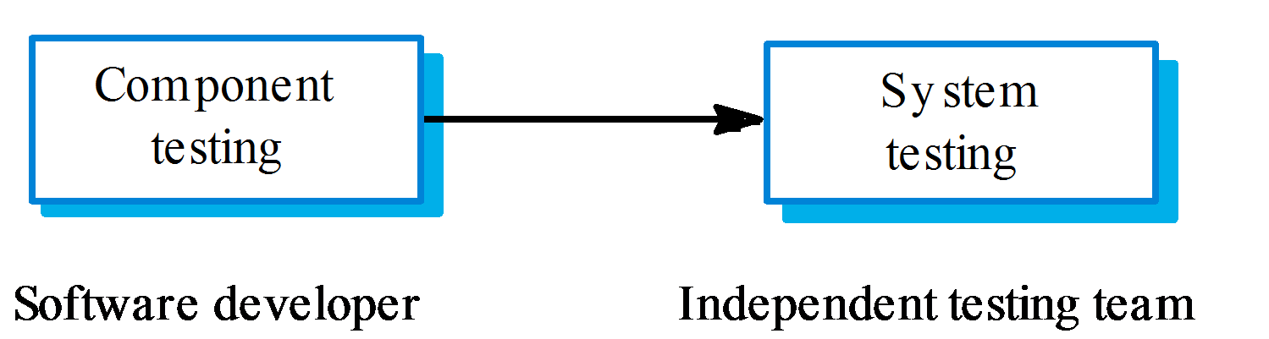

Slide 37

🞂​The goal of defect testing is to discover defects in programs
🞂​A successful defect test is a test which causes a program to behave in an anomalous way
🞂​Tests show the presence not the absence of defects

Slide 38
🞂​ Validation testing
To demonstrate to the developer and the system customer
that the software meets its requirements;
A successful test shows that the system operates as intended.
🞂​ Defect testing
To discover faults or defects in the software where its behaviour is incorrect or not in conformance with its specification;
A successful test is a test that makes the system perform incorrectly and so exposes a defect in the system.

Slide 39
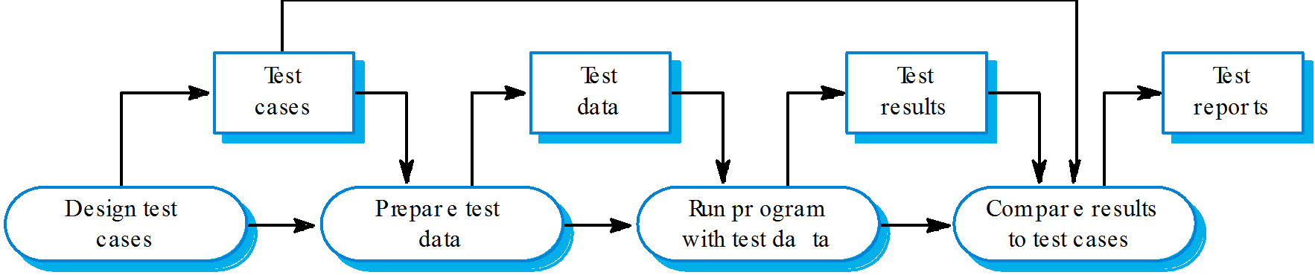

Slide 40

🞂​Only exhaustive testing can show a program is free from defects. However, exhaustive testing is impossible,
🞂​Testing policies define the approach to be used in selecting system tests:
All functions accessed through menus should be tested;
Combinations of functions accessed through the same menu should be tested;
Where user input is required, all functions must be tested
with correct and incorrect input.

Slide 41

🞂​Involves integrating components to create a system or sub-system.
🞂​May involve testing an increment to be delivered to the customer.
🞂​ Two phases:
Integration testing - the test team have access to the system source code. The system is tested as components are integrated.
Release testing - the test team test the complete system to be delivered as a black-box.

Slide 42

🞂​Involves building a system from its components and testing it for problems that arise from component interactions.
🞂​ Top-down integration
Develop the skeleton of the system and populate it with components.
🞂​ Bottom-up integration
Integrate infrastructure components then add functional components.
🞂​To simplify error localisation, systems should be incrementally integrated.

Slide 43
Manual vs Automated testing
Testing can either be done manually or using an automated testing tool:
Manual - This testing is performed without taking help of automated testing tools. The software tester prepares test cases for different sections and levels of the code, executes the tests and reports the result to the manager.
Manual testing is time and resource consuming. The tester needs to confirm whether or not right test cases are used. Major portion of testing involves manual testing.

Slide 44
Manual vs Automated testing
Automated This testing is a testing procedure done with aid of automated testing tools. The limitations with manual testing can be overcome using automated test tools.

Slide 45
A
T1
T1
A
T1
T2
A
T2
B
T2
B
T3
B
T3
C
T3
T4
C
T4
D
T5
Testsequence1
Testsequence2
Testsequence3

Slide 46

🞂​ Architectural validation
Top-down integration testing is better at discovering errors
in the system architecture.
🞂​ System demonstration
Top-down integration testing allows a limited demonstration at an early stage in the development.
🞂​ Test implementation
Often easier with bottom-up integration testing.
🞂​ Test observation
Problems with both approaches. Extra code may be required to observe tests.

Slide 47
Testing Approaches
Tests can be conducted based on two approaches:
Functionality testing
Implementation testing
When functionality is being tested without taking the actual implementation in concern it is known as black-box testing.
In otherword Black box testing is a software testing methodology in which the tester analyzes the functionality of an application without a thorough knowledge of its internal design.

Slide 48
Testing Approaches (Cont…)
The other side is known as white-box testing where not only functionality is tested but the way it is implemented is also analysed.
In white box testing, the tester is knowledgeable of the internal design of the application and analyzes it during testing.

Slide 49
Testing
Exhaustive tests are the best-desired method for a perfect testing.
Every single possible value in the range of the input and output values is tested.
It is not possible to test each and every value in real
world scenario if the range of values is large.

Slide 50



Black-box testing
Advantage
Yields large amount of data
No trained interviewer needed
Disadvantage
Require explicit instruction
Returns tend to be low

Slide 51
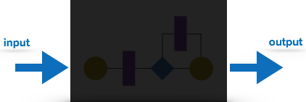
Black-box testing
It is carried out to test functionality of the program. It is also called ‘Behavioral’ testing.
The tester in this case, has a set of input values and respective desired results.
On providing input, if the
the
output matches with
desired results, the program is tested ‘ok’, and problematic otherwise.
In this testing method, the design and structure of the code are not known to the tester, and testing engineers and end users conduct this test on the software.

Slide 52
Black-box testing techniques:
Equivalence class - The input is divided into similar classes. If one element of a class passes the test, it is assumed that all the class is passed.
Boundary values - The input is divided into higher and lower end values. If these values pass the test, it is assumed that all values in between may pass too.
Cause-effect graphing - In both previous methods, only one input value at a time is tested. Cause (input) – Effect (output) is a testing technique where combinations of input values are tested in a systematic way.
Pair-wise Testing - The behavior of software depends on multiple parameters. In pairwise testing, the multiple parameters are tested pair- wise for their different values.
State-based testing - The system changes state on provision of input. These systems are tested based on their states and input.

Slide 53

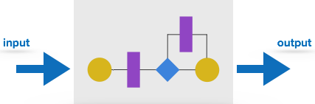
White-box testing
It is conducted to test program and its implementation, in order to improve code efficiency or structure.
It is also known as ‘Structural’ testing.
In this testing method, the design and structure of the code are known to the tester. Programmers of the code conduct this test on the code.

Slide 54
White-Box testing techniques
The below are some White-box testing techniques:
Control-flow testing - The purpose of the control- flow testing to set up test cases which covers all statements and branch conditions.
The branch conditions are tested for both being true and false, so that all statements can be covered.
Data-flow testing - This testing technique emphasis to cover all the data variables included in the program.
It tests where the variables were declared and defined and
where they were used or changed.

Slide 55

🞂​The process of testing a release of a system that will be distributed to customers.
🞂​Primary goal is to increase the supplier’s confidence that the system meets its requirements.
🞂​Release testing is usually black-box or functional testing
Based on the system specification only;
Testers do not have knowledge of the system implementation.

Slide 56

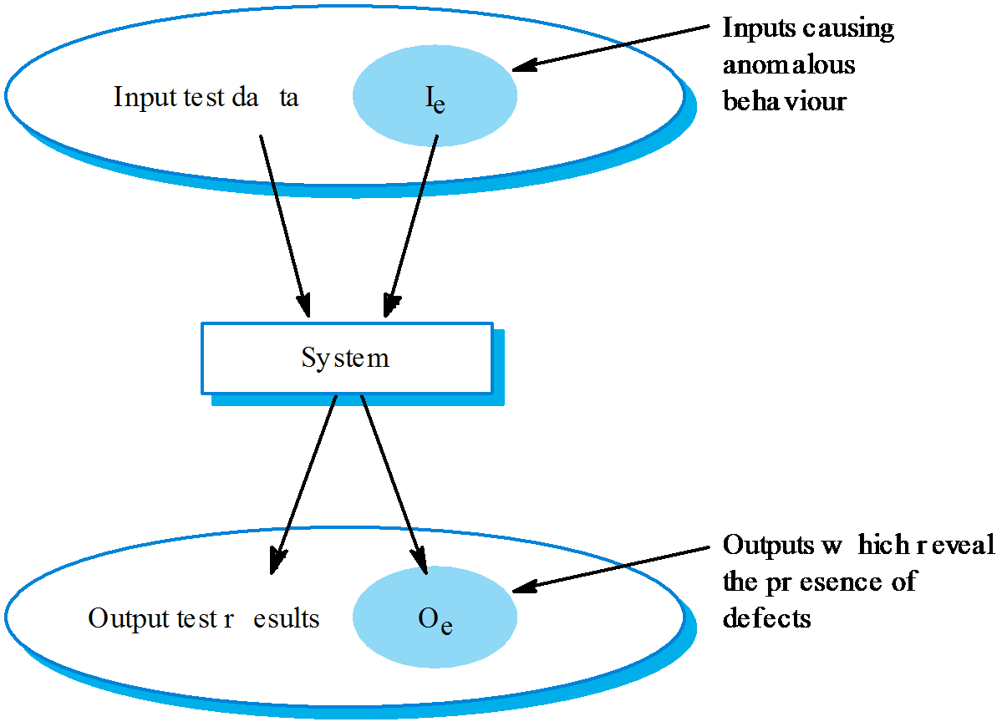

Slide 57

🞂​Testing guidelines are hints for the testing team to help them choose tests that will reveal defects in the system
Choose inputs that force the system to generate all error messages;
Design inputs that cause buffers to overflow;
Repeat the same input or input series several times;
Force invalid outputs to be generated;
Force computation results to be too large or too small.

Slide 58

A studen t in Scotland is studying A merican History and has been asked to write a paper on ÔFrontier mentality in the American West from 1840 to 1880Õ.To do this, she need s to find sources from a range o f libraries. She logs on to the LIBSYS system and uses the search facility to discover if she can acce ss original docu ments from that time. She discovers sources in various US university libraries and down loads copies of some of these. However, for one docu ment, she needs to have confirmation from her university that she is a genu ine studen t and that use is for non-commercial purposes. The student then uses the facility in LIBSYS that can reque st such permission and registers her
reques t. If granted, the docu ment will be downloaded to the registered libraryÕs server and printed for her. She receives a message f rom LIBSYS telling her that she will receive an e-mail message when th e printed docu ment is available for collection.

Slide 59

T est the login mechanism using correct and incorrect logins to check that valid users are accepted and invalid users are rejected.
T est the search facility using diff erent queries against known sources to check that the search mechanism is actually finding documents.
T est the system presentation facility to check that information about documents is displayed properly.
T est the mechanism to request permission for downloading.
T est the e-mail response indicating that the downloaded document is available.

Slide 60

🞂​Use cases can be a basis for deriving the tests for a system. They help identify operations to be tested and help design the required test cases.
🞂​From an associated sequence diagram, the inputs and outputs to be created for the tests can be identified.

Slide 61
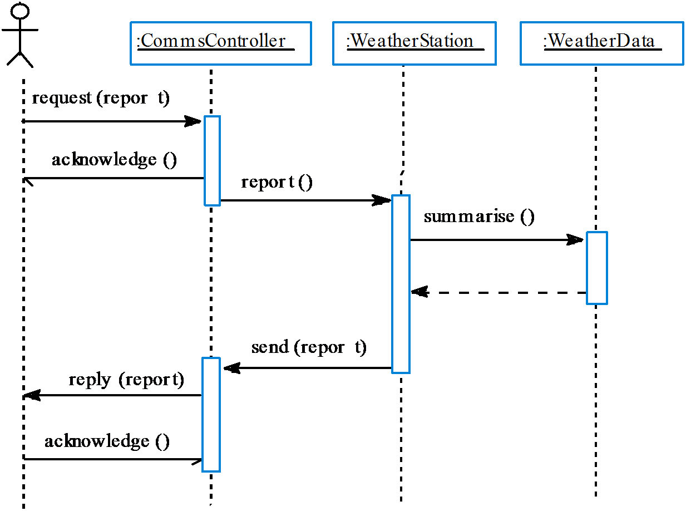

Slide 62

🞂​Part of release testing may involve testing the emergent properties of a system, such as performance and reliability.
🞂​Performance tests usually involve planning a series of tests where the load is steadily increased until the system performance becomes unacceptable.

Slide 63

🞂​ Exercises the system beyond its maximum design load. Stressing the system often causes defects to come to light.
🞂​Stressing the system test failure behaviour.. Systems should not fail catastrophically. Stress testing checks for unacceptable loss of service or data.
🞂​Stress testing is particularly relevant to distributed systems that can exhibit severe degradation as a network becomes overloaded.

Slide 64

🞂​Component or unit testing is the process of testing individual components in isolation.
🞂​ It is a defect testing process.
🞂​ Components may be:
Individual functions or methods within an object;
Object classes with several attributes and methods;
Composite components with defined interfaces used to access their functionality.

Slide 65

🞂​ Complete test coverage of a class involves
Testing all operations associated with an object;
Setting and interrogating all object attributes;
Exercising the object in all possible states.
🞂​Inheritance makes it more difficult to design object class tests as the information to be tested is not localised.

Slide 66

🞂​Involves designing the test cases (inputs and outputs) used to test the system.
🞂​The goal of test case design is to create a set of tests that are effective in validation and defect testing.
🞂​ Design approaches:
Requirements-based testing;
Partition testing;
Structural testing.

Slide 67
🞂​A general principle of requirements engineering is that requirements should be testable.
🞂​Requirements-based testing is a validation testing technique where you consider each requirement and derive a set of tests for that requirement.

Slide 68

The user shall be able to search either all of the initial set of databases or select a subset from it.
The system shall provide appropriate viewers for the user to read documents in the document store.
Every order shall be allocated a unique identifier (ORDER_ID) that the user shall be able to copy to the ac countÕs permanent storage area.

Slide 69

Initiate user search for searches for items that are known to be present and known not to be present, where the set of databases includes 1 database.
Initiate user searches for items that are known to be present
and known not to be present, where the set of databases includes 2 databases
Initiate user searches for items that are known to be present and known not to be present where the set of databases
includes more than 2 databas es.
Select one database from the set of databas es and initiate user searches for items that are known to be presen t and known not to be present.
Select more than one database from the set of databases and initiate searches for items that are known to be present and known not to be present.

Slide 70
Testing Documentation
Testing documents are prepared at different stages –
Before Testing
Testing starts with test cases generation. Following documents are needed for reference –
SRS document - Functional Requirements document
Test Policy document - This describes how far testing should take place
before releasing the product.
Test Strategy document - This mentions detail aspects of test team, responsibility matrix and rights/responsibility of test manager and test engineer.
Traceability Matrix document - This is SDLC document, which is related to requirement gathering process. As new requirements come, they are added to this matrix. These matrices help testers know the source of requirement. They can be traced forward and backward.

Slide 71


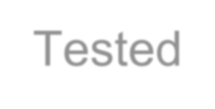

Testing Documentation
Testing documents are prepared at different stages –
The following documents may be required while testing is started and is being done:
Test Case document - This document contains list of tests required to be conducted. It includes Unit test plan, Integration test plan, System test plan and Acceptance test plan.
Test description - This document is a detailed description of all test cases and procedures to execute them.
Test case report - This document contains test case report as a
result of the test.
Test logs - This document contains test logs for every test case report.

Slide 72
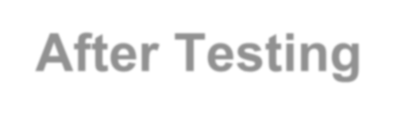
Testing Documentation
Testing documents are prepared at different stages –
The following documents may be generated after testing :
Test summary - This test summary is collective analysis of all test reports and logs. It summarizes and concludes if the software is ready to be launched. The software is released under version control system if it is ready to launch.

Slide 73
Testing vs. Quality Control, Quality
Assurance and Audit
We need to understand that software testing is different from software quality assurance, software quality control and software auditing.
(1) Software quality assurance
- These are software
development process monitoring means, by which it is assured that all the measures are taken as per the standards of organization.
This monitoring is done to make sure that proper software
development methods were followed.

Slide 74
(2) Software quality control
This is a system to maintain the quality of software product.
It may include functional and non-functional aspects of software product, which enhance the goodwill of the organization.
This system makes sure that the customer is receiving quality product for their requirement and the product certified as ‘fit for use’.

Slide 75
(3) Software audit - This is a review of procedure used by the organization to develop the software.
A team of auditors, independent of development team examines the software process, procedure, requirements and other aspects of SDLC.
The purpose of software audit is to check that software and its development process, both conform standards, rules and regulations.

Slide 76

🞂​ Sometime called white-box testing.
🞂​Derivation of test cases according to program structure. Knowledge of the program is used to identify additional test cases.
🞂​Objective is to exercise all program statements (not all path combinations).

Slide 77
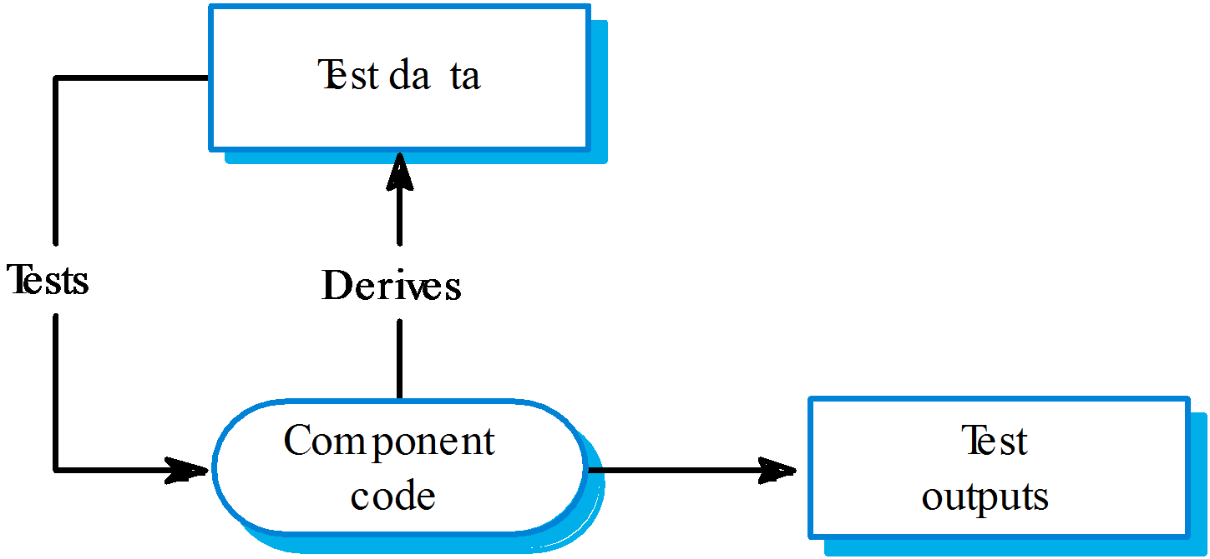

Slide 78
🞂​ Pre-conditions satisfied, key element in array.
🞂​Pre-conditions satisfied, key element not in array.
🞂​ Pre-conditions unsatisfied, key element in array.
🞂​Pre-conditions unsatisfied, key element not in array.
🞂​ Input array has a single value.
🞂​ Input array has an even number of values.
🞂​ Input array has an odd number of values.

Slide 79
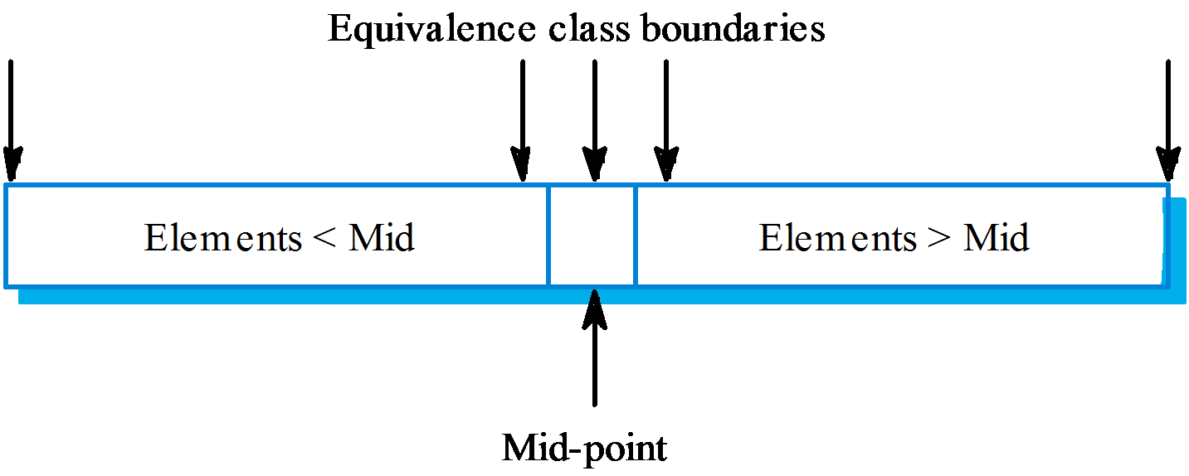

Slide 80
Input array (T) | Key (Key) | Output (Found, L)
17 | 17 | true, 1
17 | 0 | false, ??
17, 21, 23, 29 | 17 | true, 1
9, 16, 18, 30, 31, 41, 45 | 45 | true, 7
17, 18, 21, 23, 29, 38, 41 | 23 | true, 4
17, 18, 21, 23, 29, 33, 38 | 21 | true, 3
12, 18, 21, 23, 32 | 23 | true, 4
21, 23, 29, 33, 38 | 25 | false, ??

Slide 81

🞂​The objective of path testing is to ensure that the set of test cases is such that each path through the program is executed at least once.
🞂​The starting point for path testing is a program flow graph that shows nodes representing program decisions and arcs representing the flow of control.
🞂​Statements with conditions are therefore nodes in the flow graph.

Slide 82
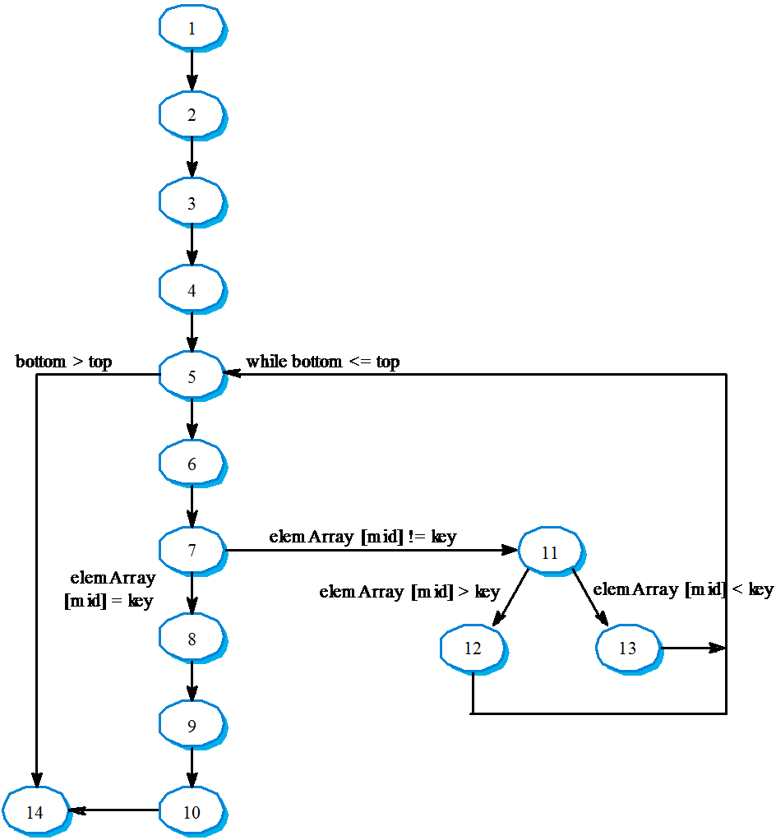

Slide 83

🞂​ 1, 2, 3, 4, 5, 6, 7, 8, 9, 10, 14
🞂​ 1, 2, 3, 4, 5, 14
🞂​ 1, 2, 3, 4, 5, 6, 7, 11, 12, 5, …
🞂​ 1, 2, 3, 4, 6, 7, 2, 11, 13, 5, …
🞂​Test cases should be derived so that all of these paths are executed
🞂​A dynamic program analyser may be used to check that paths have been executed

Slide 84

🞂​Testing is an expensive process phase. Testing workbenches provide a range of tools to reduce the time required and total testing costs.
🞂​Systems such as Junit support the automatic execution of tests.
🞂​Most testing workbenches are open systems because testing needs are organisation-specific.
🞂​They are sometimes difficult to integrate with closed design and analysis workbenches.

Slide 85

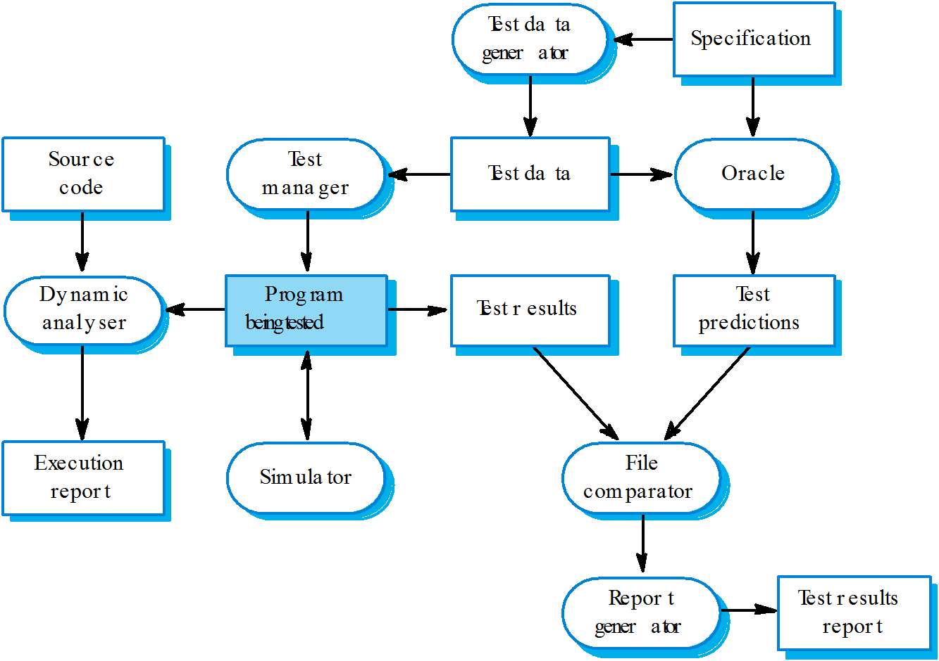

Slide 86
🞂​Scripts may be developed for user interface simulators and patterns for test data generators.
🞂​Test outputs may have to be prepared manually for comparison.
🞂​Special-purpose file comparators may be developed.

Slide 87

🞂​Testing can show the presence of faults in a system; it cannot prove there are no remaining faults.
🞂​Component developers are responsible for component testing; system testing is the responsibility of a separate team.
🞂​Integration testing is testing increments of the system; release testing involves testing a system to be released to a customer.
🞂​Use experience and guidelines to design test cases in defect testing.

Slide 88
🞂​ Interface testing is designed to discover defects
in the interfaces of composite components.
🞂​Equivalence partitioning is a way of discovering test cases - all cases in a partition should behave in the same way.
🞂​Structural analysis relies on analysing a program and deriving tests from this analysis.
🞂​Test automation reduces testing costs by supporting the test process with a range of software tools.

Slide 89
The testing process
A description of the major phases of the testing process. These might be as described earlier in this chapter.
Requirements traceability
Users are most interested in the system meeting its requirements and testing should be planned so that all requirements are individually tested.
Tested items
The products of the software process that are to be tested should be specified.
Testing schedule
An overall testing schedule and resource allocation for this schedule.
This, obv iously, is linked to the more general project development schedule.
Test recording procedures
It is not enough simply to run tests. The results of the tests must be
systematically recorded. It must be possible to audit the testing process to check that it been carried out correctly.
Hardware and software requirements
This section should set out software tools required and estimated hardware utilisation.
Constraints
Constraints affecting the testing process such as staff shortages should be anticipated in this section.

Slide 90
Software Maintenance
What is Software Maintenance?
Software Maintenance is a very broad activity that includes error corrections, enhancements of capabilities, deletion of obsolete capabilities, and optimization.

Slide 91
Software Maintenance
Categories of Maintenance
Corrective maintenance
This refer to modifications initiated by defects in the software.
Adaptive maintenance
It includes modifying the software to match changes in the ever changing environment.
Perfective maintenance
It means improving processing efficiency or performance, or restructuring the software to improve changeability. This may include enhancement of existing system functionality, improvement in computational efficiency etc.

Slide 92
Software Maintenance
Other types of maintenance
There are long term effects of corrective, adaptive and perfective changes. This leads to increase in the complexity of the software, which reflect deteriorating structure. The work is required to be done to maintain it or to reduce it, if possible. This work may be named as preventive maintenance.

Slide 93
Software Maintenance
Corrective (21%)
Perfective
Adaptive Preventive Corrective
Preventive (4%)
Perfective (50%)
Adaptive (25%)
Fig. 1: Distribution of maintenance effort

Slide 94
Software Maintenance
Problems During Maintenance
Often the program is written by another person or group of persons.
Often the program is changed by person who did not understand it
clearly.
Program listings are not structured.
High staff turnover.
Information gap.
Systems are not designed for change.

Slide 95
Software Maintenance
Maintenance is Manageable
A common misconception about maintenance is that it is not manageable.
Report of survey conducted by Lientz & Swanson gives some interesting observations:
1 | Emergency debugging | 12.4%
2 | Routine debugging | 9.3%
3 | Data environment adaptation | 17.3%
4 | Changes in hardware and OS | 6.2%
5 | Enhancements for users | 41.8%
6 | Documentation Improvement | 5.5%
7 | Code efficiency improvement | 4.0%
8 | Others | 3.5%
Table 1: Distribution of maintenance effort

Slide 96
Software Maintenance
Kinds of maintenance requests
1 | New reports | 40.8%
2 | Add data in existing reports | 27.1%
3 | Reformed reports | 10%
4 | Condense reports | 5.6%
5 | Consolidate reports | 6.4%
6 | Others | 10.1%
Table 2: Kinds of maintenance requests

Slide 97
Software Maintenance
Potential Solutions to Maintenance Problems
Budget and effort reallocation
Complete replacement of the system
Maintenance of existing system
10
0

Slide 98
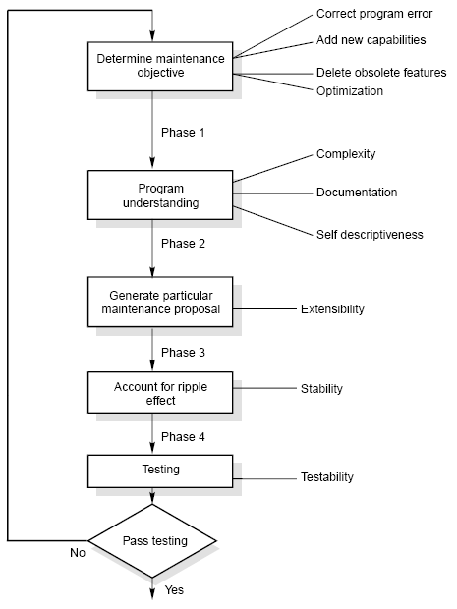
Software Maintenance
The Maintenance Process
Fig. 2: The software
maintenance process

Slide 99
Software Maintenance
Program Understanding
The first phase consists of analyzing the program in order to understand.
Generating Particular Maintenance Proposal
The second phase consists of generating a particular maintenance proposal to accomplish the implementation of the maintenance objective.
Ripple (flow) Effect
The third phase consists of accounting for all of the ripple effect as a consequence of program modifications.

Slide 100
Software Maintenance
Modified Program Testing
The fourth phase consists of testing the modified program to ensure that the
modified program has at least the same reliability level as before.
Maintainability
Each of these four phases and their associated software quality attributes are critical to the maintenance process. All of these factors must be combined to form maintainability.

Slide 101
Software Maintenance
Regression Testing
Regression testing is the process of retesting the modified parts of the software and ensuring that no new errors have been introduced into previously test code.
“Regression testing tests both the modified code and other parts of the program that may be affected by the program change. It serves many purposes :
increase confidence in the correctness of the modified program
locate errors in the modified program
preserve the quality and reliability of software
ensure the software’s continued operation

Slide 102
Software Maintenance
Development Testing Versus Regression Testing
Sr. No. | Development testing | Regression testing
1. | We create test suites and test plans | We can make use of existing test suite and test plans
2. | We test all software components | We retest affected components that have been modified by modifications.
3. | Budget gives time for testing | Budget often does not give time for regression testing.
4. | We perform testing just once on a software product | We perform regression testing many times over the life of the software product.
5. | Performed under the pressure of release date of the software | Performed in crisis situations, under greater time constraints.

Slide 103
Software Maintenance
Regression Test Selection
Regression testing is very expensive activity and consumes significant amount of effort / cost. Many techniques are available to reduce this effort/ cost.
Reuse the whole test suite
Reuse the existing test suite, but to apply a regression test selection technique to select an appropriate subset of the test suite to be run.

Slide 104
Software Maintenance
Fragment A |  | Fragment B (modified form of A)
S₁ | y = (x - 1) * (x + 1) | S₁’ | y = (x -1) * (x + 1)
S₂ | if (y = 0) | S₂’ | if (y = 0)
S₃ | return (error) | S₃’ | return (error)
S₄ | else | S₄’ | else
S₅ | ⎛ 1 ⎞ return ⎜ ⎟ ⎝ ^{y} ⎠ | S₅’ | return ^{⎛ 1 ⎞} ⎜ ⎟ ⎝ y − 3 ⎠
Fig. 8: code fragment A and B

Slide 105
Software Maintenance
Test cases
Test number | Input | Execution History
t₁ | x = 1 | S₁, S₂, S₃
t₂ | x = -1 | S₁, S₂, S₃
t₃ | x = 2 | S₁, S₂, S₅
t₄ | x = 0 | S₁, S₂, S₅
Fig. 9: Test cases for code fragment A of Fig. 8

Slide 106
Software Maintenance
If we execute all test cases, we will detect this divide by zero fault. But we have to minimize the test suite. From the fig. 9, it is clear that test cases t₃ and t₄ have the same execution history i.e. S₁, S₂, S₅. If few test cases have the same execution history; minimization methods select only one test case. Hence, either t₃ or t₄ will be selected. If we select t₄ then fine otherwise fault not found.
Minimization methods can omit some test cases that might expose fault in the modified software and so, they are not safe.
A safe regression test selection technique is one that, under certain assumptions, selects every test case from the original test suite that can expose faults in the modified program.

Slide 107
Software Maintenance
Selective Retest Techniques
Selective retest techniques may be more economical than the “retest-all” technique.
Selective retest techniques are broadly classified in three categories :
Coverage techniques : They are based on test coverage criteria. They locate coverable program components that have been modified, and select test cases that exercise these components.
Minimization techniques: They work like coverage techniques, except that they select minimal sets of test cases.
Safe techniques: They do not focus on coverage criteria; instead they select every test case that cause a modified program to produce different output than its original version.
11
0

Slide 108
Software Maintenance
Rothermal identified categories in which regression test selection techniques can be compared and evaluated. These categories are:
Inclusiveness measures the extent to which a technique chooses test cases that will cause the modified program to produce different output than the original program, and thereby expose faults caused by modifications.
Precision measures the ability of a technique to avoid choosing test cases that will not cause the modified program to produce different output than the original program.
Efficiency measures the computational cost, and thus, practically, of a technique.
Generality measures the ability of a technique to handle realistic and diverse language constructs, arbitrarily complex modifications, and realistic testing applications.

Slide 109
Software Maintenance
Reverse Engineering
Reverse engineering is the process followed in order to find difficult, unknown and hidden information about a software system.

Slide 110
Software Maintenance
Scope and Tasks
The areas there reverse engineering is applicable include (but not limited to):
Program comprehension
Redocumentation and/ or document generation
Recovery of
design approach and design details at any level of
abstraction
Identifying reusable components
Identifying components that need restructuring
Recovering business rules, and
Understanding high level system description

Slide 111
Software Maintenance
Reverse Engineering encompasses a wide array of tasks related to understanding and modifying software system. This array of tasks can be broken into a number of classes.
Mapping between application and program domains
Problem/ application
domain
Mapping
Programming/ implement domain
Fig. 10: Mapping between application and domains program
114

Slide 112
Software Maintenance
Mapping between concrete and abstract levels
Rediscovering high level structures
Finding missing links between program syntax and semantics
To extract reusable component

Slide 113
Software Maintenance
Levels of Reverse Engineering
Reverse Engineers detect low level implementation constructs and replace them with their high level counterparts.
The process eventually results in an incremental formation of an overall architecture of the program.

Slide 114
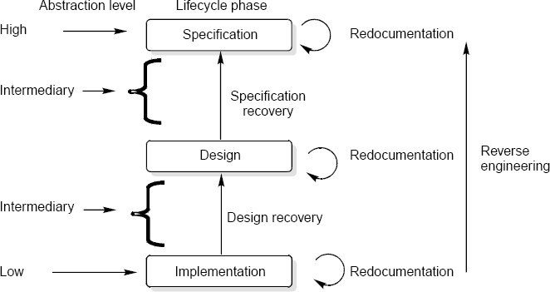
Software Maintenance
Fig. 11: Levels of abstraction

Slide 115
Software Maintenance
Redocumentation
Redocumentation is the recreation of a semantically equivalent representation within the same relative abstraction level.
Design recovery
Design recovery entails identifying and extracting meaningful higher level abstractions beyond those obtained directly from examination of the source code. This may be achieved from a combination of code, existing design documentation, personal experience, and knowledge of the problem and application domains.

Slide 116
Software Maintenance
Software RE-Engineering
Software re-engineering is concerned with taking existing legacy systems and re-implementing them to make them more maintainable.
The critical distinction between re-engineering and new software development is the starting point for the development as shown in Fig.12.

Slide 117
Software Maintenance
System specification
Existing
software system
Design and implementation
Understanding and transformation
New system
Re-engineered
system
Fig. 12: Comparison of new software development with re-engineering
12
0

Slide 118
Software Maintenance
The following suggestions may be useful for the modification of the legacy code:
Study code well before attempting changes
Concentrate on overall control flow and not coding
Heavily comment internal code
Create Cross References
Build Symbol tables
Use own variables, constants and declarations to localize the effect
Keep detailed maintenance document
Use modern design techniques

Slide 119
Software Maintenance
Source Code Translation
Hardware platform update: The organization may wish to change its standard hardware platform. Compilers for the original language may not be available on the new platform.
Staff Skill Shortages: There may be lack of trained maintenance staff for the original language. This is a particular problem where programs were written in some non standard language that has now gone out of general use.
Organizational policy changes: An organization may decide to standardize on a particular language to minimize its support software costs. Maintaining many versions of old compilers can be very expensive.

Slide 120
Software Maintenance
Program Restructuring
Control flow driven restructuring: This involves the imposition of a clear control structure within the source code and can be either inter modular or intra modular in nature.
Efficiency driven restructuring: This involves restructuring a function or algorithm to make it more efficient. A simple example is the replacement of an IF-THEN-ELSE-IF-ELSE construct with a CASE construct.

Slide 121
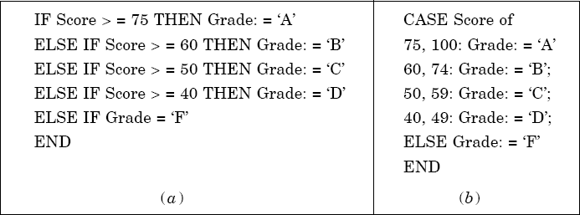
Software Maintenance
Fig. 13: Restructuring a program

Slide 122
Software Maintenance
3. Adaption driven restructuring: This involves changing the coding style in order to adapt the program to a new programming language or new operating environment, for instance changing an imperative program in PASCAL into a functional program in LISP.

Slide 123
Software Maintenance
Configuration Management
The process of software development and maintenance is controlled is called configuration management. The configuration management is different in development and maintenance phases of life cycle due to different environments.
Configuration Management Activities
The activities are divided into four broad categories.
The identification of the components and changes
The control of the way by which the changes are made
Auditing the changes
Status accounting recording and documenting all the activities that have take place

Slide 124
Software Maintenance
The following documents are required for these activities
Project plan
Software requirements specification document
Software design description document
Source code listing
Test plans / procedures / test cases
User manuals

Slide 125
Software Maintenance
Software Versions
Two types of versions namely revisions (replace) and variations (variety). Version Control :
A version control tool is the first stage towards being able to manage multiple versions. Once it is in place, a detailed record of every version of the software must be kept. This comprises the
Name of each source code component, including the variations and revisions
The versions of the various compilers and linkers used
The name of the software staff who constructed the component
The date and the time at which it was constructed

Slide 126
Software Maintenance
Change Control Process
Change control process comes into effect when the software and associated documentation are delivered to configuration management change request form (as shown in fig. 14), which should record the recommendations regarding the change.

Slide 127
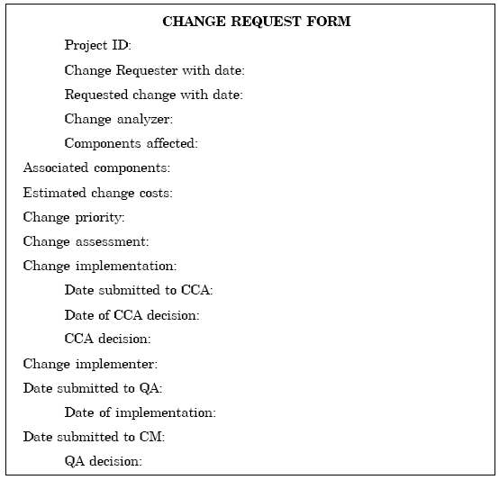
Software Maintenance
Fig. 14: Change request form
13
0

Slide 128
Software Maintenance
Documentation
Software documentation is the written record of the facts about a software system recorded with the intent to convey purpose, content and clarity.

Slide 129
Software Maintenance
User Documentation
S.No. | Document | Function
1. | System Overview | Provides general description of system’s functions.
2. | Installation Guide | Describes how to set up the system, customize it to local hardware needs and configure it to particular hardware and other software systems.
3. | Beginner’s Guide | Provides simple explanations of how to start using the system.
4. | Reference Guide | Provides in depth description of each system facility and how it can be used.
5. | Enhancement | Booklet Contains a summary of new features.
6. | Quick reference card | Serves as a factual lookup.
7. | System administration | Provides information on services such as net-working, security and upgrading.
Table 5: User Documentation

Slide 130
Software Maintenance
System Documentation
It refers to those documentation containing all facets of system, including analysis, specification, design, implementation, testing, security, error diagnosis and recovery.

Slide 131
Software Maintenance
System Documentation
S.No. | Document | Function
1. | System Rationale | Describes the objectives of the entire system.
2. | SRS | Provides information on exact requirements of system as agreed between user and developers.
3. | Specification/ Design | Provides description of: How system requirements are implemented. How the system is decomposed into a set of interacting program units. The function of each program unit.
4. | Implementation | Provides description of: How the detailed system design is expressed in some formal programming language. Program actions in the form of intra program comments.

Slide 132
Software Maintenance
S.No. | Document | Function
5. | System Test Plan | Provides description of how program units are tested individually and how the whole system is tested after integration.
6. | Acceptance Test Plan | Describes the tests that the system must pass before users accept it.
7. | Data Dictionaries | Contains description of all terms that relate to the software system in question.
Table 6: System Documentation

Slide 133



Thank You!

